Slide 1

Stable Matching for Dynamic Ridesharing
Raghav, Vineeth, Nikhil, Kamran, Victoire

Slide 2
Content
1
2
3
Introduction
Objective
Case Details
Model Building
Variables
Assumptions & Evaluation Metrics
Pre-Processing & Feasible Pairs
Static Model
Static Model Formulation
Weighting strategies
Code Walkthrough
Dynamic Model
Dynamic Model Formulation
Dynamic Model Overview
Conclusion
Static Problem Solutions
Interpretation

Slide 3

Introduction

Slide 4
Objective
Dynamic ridesharing optimization improves urban mobility by:
Increasing efficiency & profitability
Enhancing user satisfaction
Lowering environmental impacts
Stable matches are essential for sustained user engagement and long-term success.
01
02
Primary Goal:
Secondary Objectives:
Develop a mathematically optimized solution for stable driver-rider matching using Integer Linear Programming (ILP).
Maximize net distance saved while matching
Maximizing the number of successful matches

Slide 5

2
Model Building

Slide 6


Variables
ω_{a}: origin of participant a
δ_{a}: destination of participant a
a can be driver (d) or rider (r)
τ(a): announcement time
e(a): earliest departure time
l(a): latest arrival time
S(ω_{a}, δ_{a} ): distance between origin and destination
T(ω_{a}, δ_{a} ): travel time between origin and destination
q(a) = l(a) - T(ω_{a}, δ_{a} ): latest departure time
f(a) = q(a) – e(a): flexibility of the participant

Slide 7



Assumptions & Evaluation Metrics
Assumptions
Driver’s announcement contains ω_{d}, δ_{d}, e(d) and l(d)
Rider’s announcement contains ω_{r}, δ_{r}, e(r) and l(r)
1 driver per trip
1 rider per trip
Evaluation Metrics
1. Matching rate (MR): $\frac{Σ[n° of matched announcements]}{Σ[n° of trip announcements]}$
2. Average total vehicle-kilometres savings (AKS): total kilometres from matching algorithm versus the both parties taking individual trips

Slide 8

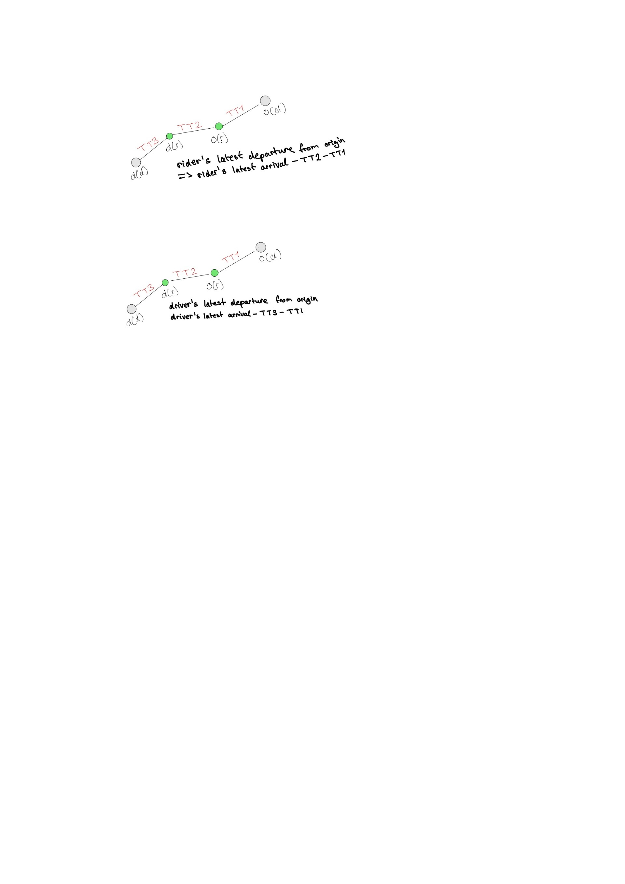
Pre-Processing
_{MINIMUM of:}
1) Latest rider arrival time – travel time origin (r) to destination (r) – travel time origin (d) to origin (r)
_{OR}
2) Latest driver arrival time – travel time destination (d) to destination (r) – travel time origin (d) to origin (r)
Check for pair-feasibility
Calculate overlap between the driver and the rider time windows by comparing the latest time that the driver must depart (k) and the earliest departure times of both the driver and the rider.
The match (d,r) can be deemed feasible only if
Difference in driver’s travel time is greater or equal to 0:
k – MAXIMUM OF(current time, earliest driver departure time)
Difference in rider’s travel time is greater or equal to 0:
k + travel time origin (d) to origin (r) – MAXIMUM OF(current time, earliest rider departure time
Notes:
Latest time driver must depart to successfully pick up and drop off the rider (k) is the (slide)
Driver: This condition checks if the latest possible departure time k for the driver is later than or equal to the maximum of the current time and the driver’s earliest departure time. If it means the driver can depart within the allowed window.
Rider: This condition checks if the driver can pick up the rider within the allowed window. The left-hand side represents the time the driver will arrive at the rider’s origin, and it must be later than or equal to the maximum of the current time and the rider’s earliest departure time.

Slide 9

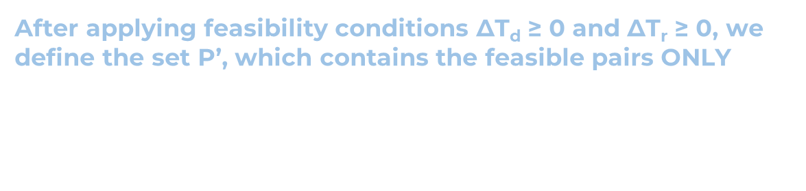
Feasible Pairs
Aim: identifying infeasible matches and removing the corresponding driver-rider pair from consideration.
A match (d,r) is feasible if the time windows of driver d (departure time and arriving time) and rider r (pick-up time and drop off time) overlap and are both satisfied.
After applying feasibility conditions ΔT_{d} ≥ 0 and ΔT_{r} ≥ 0, we define the set P’, which contains the feasible pairs ONLY
$P^{′}=\left\{\left(d,r\right)∈P: ΔT_{d}≥0,∆T_{r}≥0\right\}$
With this new set, we are left with a smaller, more efficient matching problem

Slide 10
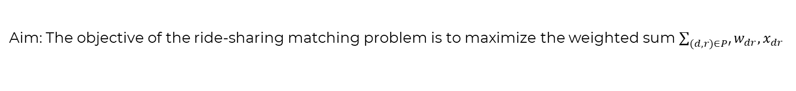




Static Model Formulation
Aim: The objective of the ride-sharing matching problem is to maximize the weighted sum $\sum_{(d,r)∈P′}{w_{dr},x_{dr}}$
$$max\sum_{(d,r)∈P′}{w_{dr}x_{dr}}$$
The goal is to maximize the total weighted contribution of each pairing
$\sum_{r∈R:(d,r)∈P′}{x_{dr}≤1 ∀d∈D}$
Each driver can match with at most one rider
$\sum_{d∈D:(d,r)∈P′}{x_{dr}≤1 ∀r∈R}$
Each rider can match with at most one driver
$x_{dr}∈\left\{0,1\right\} ∀(d,r)∈P′$
Because x_{dr} is a binary variable it can only be 0 or 1
Key characteristics:
Fixed parameters
Focuses on single scenario
Simple to compute (algorithms)
Have limitations (don’t account for uncertainties/fluctuations)

Slide 11
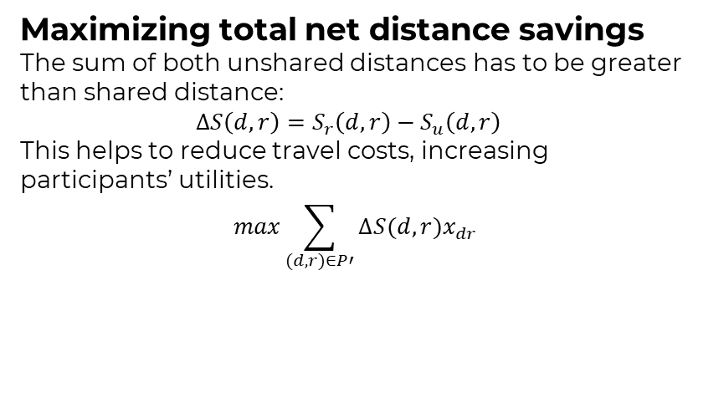
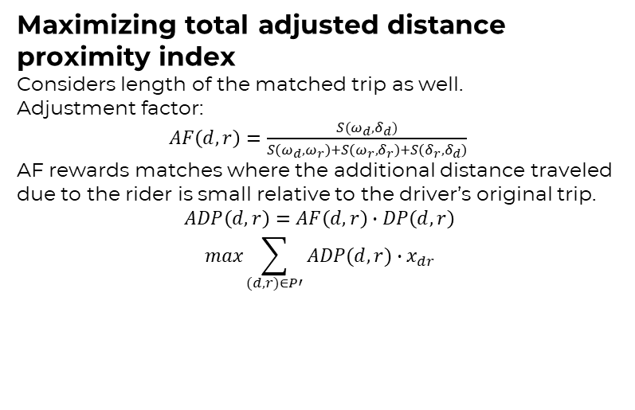


Weighting Strategies
The weights are critical, so they have to be calculated in line with the ultimate objective. We can evaluate the impact of different weights, using 4 different weighting strategies:
Maximizing total net distance savings
The sum of both unshared distances has to be greater than shared distance:
$∆S\left(d,r\right)=S_{r}\left(d,r\right)−S_{u}\left(d,r\right)$
This helps to reduce travel costs, increasing participants’ utilities.
$$max\sum_{(d,r)∈P′}{∆S(d,r)x_{dr}}$$
Maximizing total number of matches
This is critical for the ride-sharing service to be sustainable. It can be used as a measure of reliability. This would be with uniform weights w_{dr} = 1.
$$max\sum_{(d,r)∈P′}{x_{dr}}$$
Maximizing total distance proximity index
Making an index focusing on length similarity of the 2 individual trips . The closer the trips, the higher the index value:
$DP\left(d,r\right)=min⁡(\frac{S\left(ω_{d},δ_{d}\right)}{S\left(ω_{r},δ_{r}\right)},$ $\frac{S\left(ω_{r},δ_{r}\right)}{S\left(ω_{d},δ_{d}\right)}$)
We get a value between 0 and 1, the latter meaning that a pair is a good match if they are already close in proximity..
$$max\sum_{(d,r)∈P′}{DP\left(d,r\right)x_{dr}}$$
The goal of this objective function is to maximize the sum of the indices
Maximizing total adjusted distance proximity index
Considers length of the matched trip as well.
Adjustment factor:
$AF\left(d,r\right)=\frac{S(ω_{d},δ_{d})}{S\left(ω_{d},ω_{r}\right)+S\left(ω_{r},δ_{r}\right)+S\left(δ_{r},δ_{d}\right)}$
AF rewards matches where the additional distance traveled due to the rider is small relative to the driver’s original trip.
$$ADP\left(d,r\right)=AF\left(d,r\right)∙DP\left(d,r\right)$$
$$max\sum_{(d,r)∈P′}{ADP(d,r)∙x_{dr}}$$
Notes:
Xdr is binary variable. 1= pair matched, 0= not matched
We replace w_{dr} giving objective function as such: (2), it becomes the weight
3. We take the minimum of two ratios- driver’s trip length to rider’s trip length, vice versa-
The idea is similar distanced trips will have spatial correlations between their origins and destinations
4. This is an enhancement of DP, it takes into account proximity of driver and rider in terms of trip lengths but also lngth of matched trip. This is to reflect better on practicality of the match
EQUATION 1
This compares the driver’s original trip length to the total matched trip length. A smaller matched trip, where the driver deviates less from their original route will have a higher AF value and therefore higher priority.
EQUATION 2
AF adjusts the DP bc it combines trip length similarity and oracticality of the matched trip
EQUATION 3
The objective is to find the matching that maximizes the overall ADP, favoring matches that optimize both trip-length similarity and minimized deviation from the driver’s original route

Slide 12
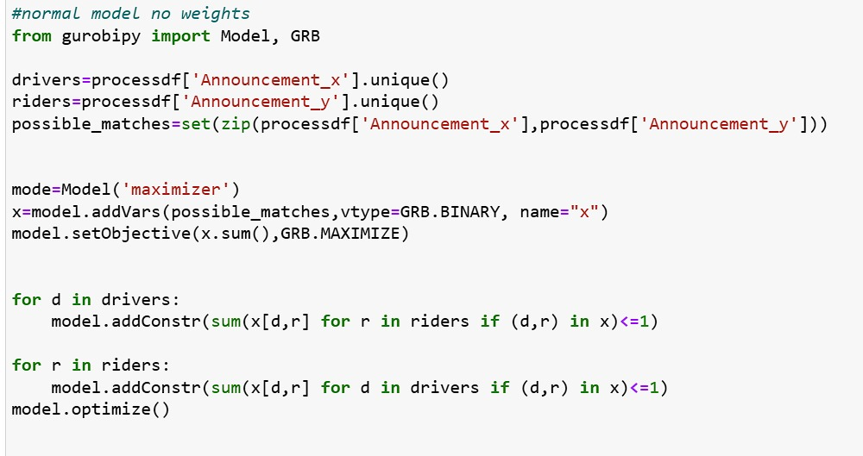
Model Formulation For Maximizing Total Matches
Setting objective function as summation of all decision variables
Creating a binary variables for each feasible driver-rider pairing
Since every match is worth the same we are summing with no weightage, so only ones and zeroes
Constraints so every driver has max one rider
Constraints so every rider has max one driver

Slide 13
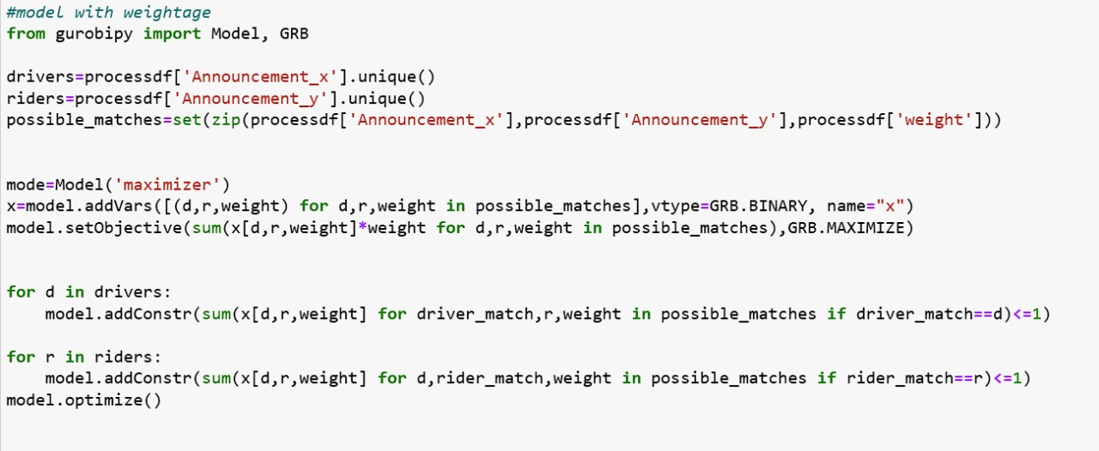
Model Formulation For Maximizing With Weightage
Depending on the maximization method the weightage values will vary but the code is the same: summing each binary variable multiplied by its weightage

Slide 14


Dynamic Model Formulation
Aim: optimize matches over multiple time steps while considering changing system states
The algorithm operates in discrete time steps T={0,p,2p,3p,… } At each time step, the matching problem is solved and matches are finalized.
As Late As Possible (ALAP)
Matches are delayed until the latest possible time, to allow for better opportunities
Finalization occurs when:
$\min\left\{q\left(d\right),q\left(r\right)\right\}<t+p$
Meaning that past the latest departure time, the algorithm will not be able to allocate matches
As Soon As α (ASA α)
Combination of ALAP’s flexibility and ASAP’s responsiveness. Matches get finalised when either:
ω_{dr} is above threshold α (sufficient),
OR
$\min\left\{q\left(d\right),q\left(r\right)\right\}<t+p$
As Soon As Possible (ASAP)
Matches are finalized immediately, prioritizing quick service over potential better future matches
Notes:
where p is the predefined time step interval.

Slide 15

Dynamic Model Overview
Dynamic matching policies determine when to finalize matches
This framework effectively:
Updates set of active announcements
Solves static matching problem using selected objective function and policy
Finalizes matches according to chosen policy
Removes expired and inactive announcements
Adaptability: Adapts to changing system states and announcements in real time
Optimization: Balances trade-off between quality of matches and service speed through dynamic policies
Scalability: Suitable for large-scale, highly dynamic ride-sharing environments

Slide 16

3
Conclusion

Slide 17
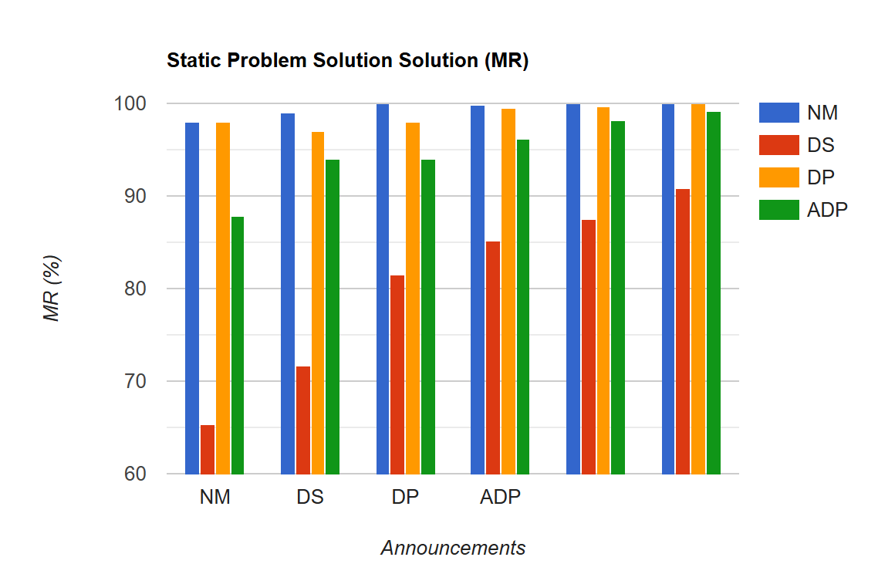
Conclusion
(MR)
50 100 200 300 400 500

Slide 18
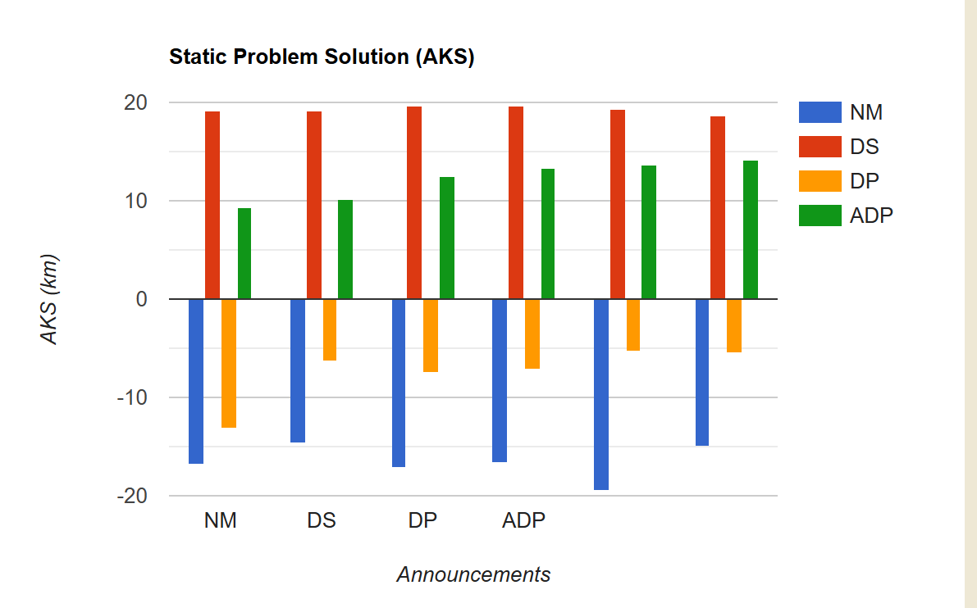
Conclusion
50 100 200 300 400 500

Slide 19


Slide 20
4
Appendix

Slide 21
Static Problem Solution Maximizing Total Number Of Matches
50D
50R
MR: 97.96%
AKS: -16.87km
100D
100R
MR: 98.99%
AKS: -14.59km
200D
200R
MR: 100%
AKS: -17.15km
300D
300R
MR: 99.83%
AKS: -16.64km
400D
400R
MR: 100%
AKS: -19.55km
500D
500R
MR: 100%
AKS: -14.94km

Slide 22
Static Problem Solution Maximizing Net Distance Savings incl. Weights
50D
50R
MR: 65.31%
AKS: 19.18km
100D
100R
MR: 71.72%
AKS: 19.11km
200D
200R
MR: 81.50%
AKS: 19.70km
300D
300R
MR: 85.14%
AKS: 19.61km
400D
400R
MR: 87.50 %
AKS: 19.33km
500D
500R
MR: 90.80%
AKS: 18.67km

Slide 23
Static Problem Solution Maximizing Total Distance Proximity Index
50D
50R
MR: 97.96%
AKS: -13.18km
100D
100R
MR: 96.97%
AKS: -6.25km
200D
200R
MR: 98.00%
AKS: -7.45km
300D
300R
MR: 99.50%
AKS: -7.15km
400D
400R
MR: 99.75%
AKS: -5.39km
500D
500R
MR: 100%
AKS: -5.45km

Slide 24
Static Problem Solution Maximizing Total Adjusted Distance Proximity Index
50D
50R
MR: 87.76%
AKS: 9.31km
100D
100R
MR: 93.94%
AKS: 10.25km
200D
200R
MR: 94.00%
AKS: 12.52km
300D
300R
MR: 96.16%
AKS: 13.39km
400D
400R
MR: 98.25%
AKS: 13.61km
500D
500R
MR: 99.20%
AKS: 14.11km

Slide 25
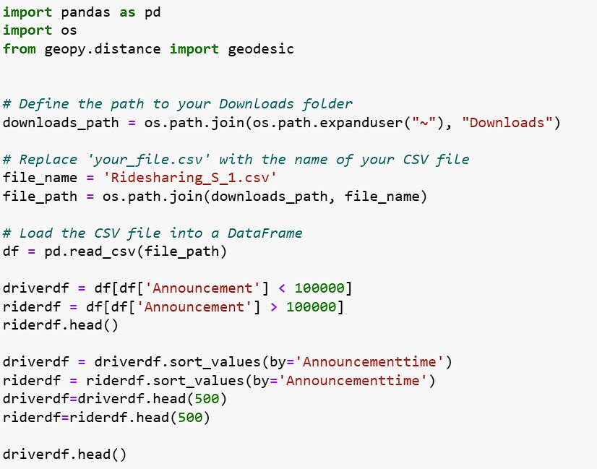
Code

Slide 26
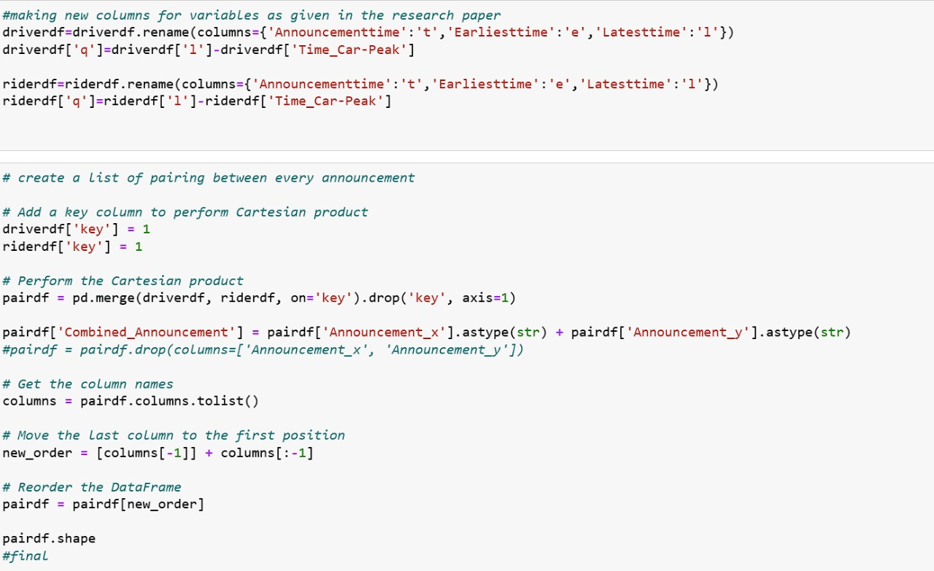
Code

Slide 27
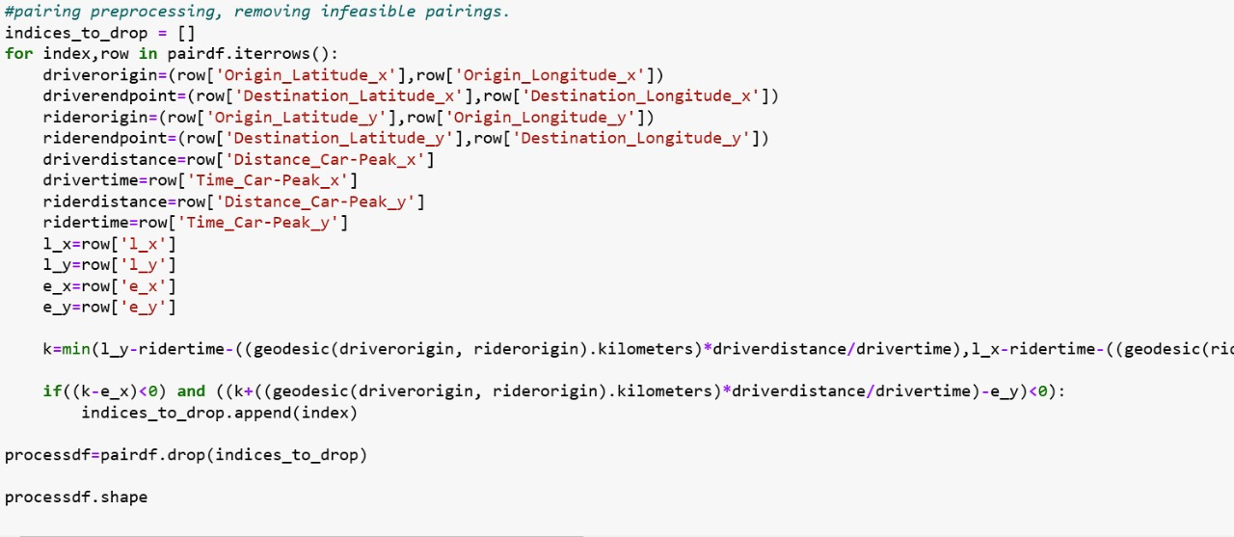
Code

Slide 28
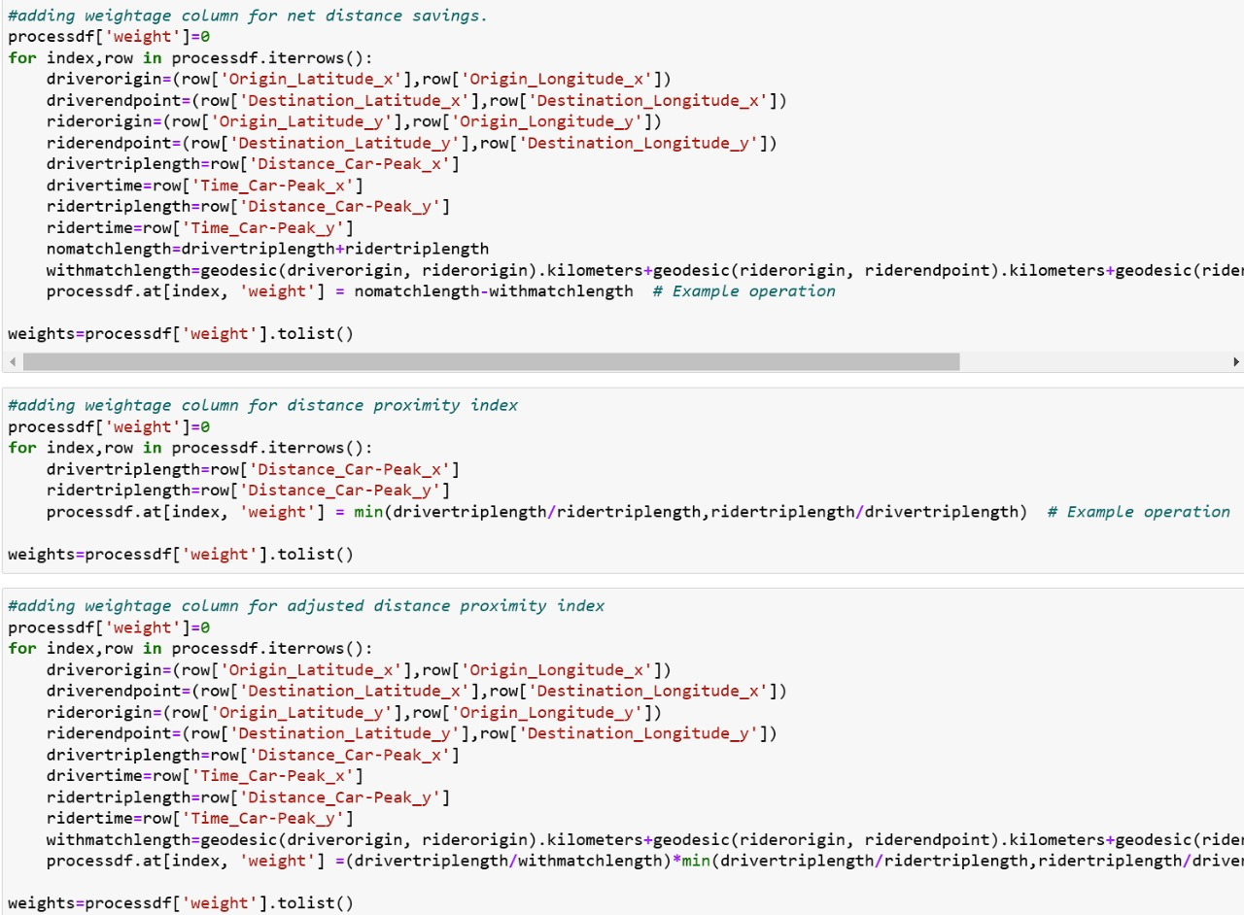
Code

Slide 29
Code

Slide 30
Code

Slide 31
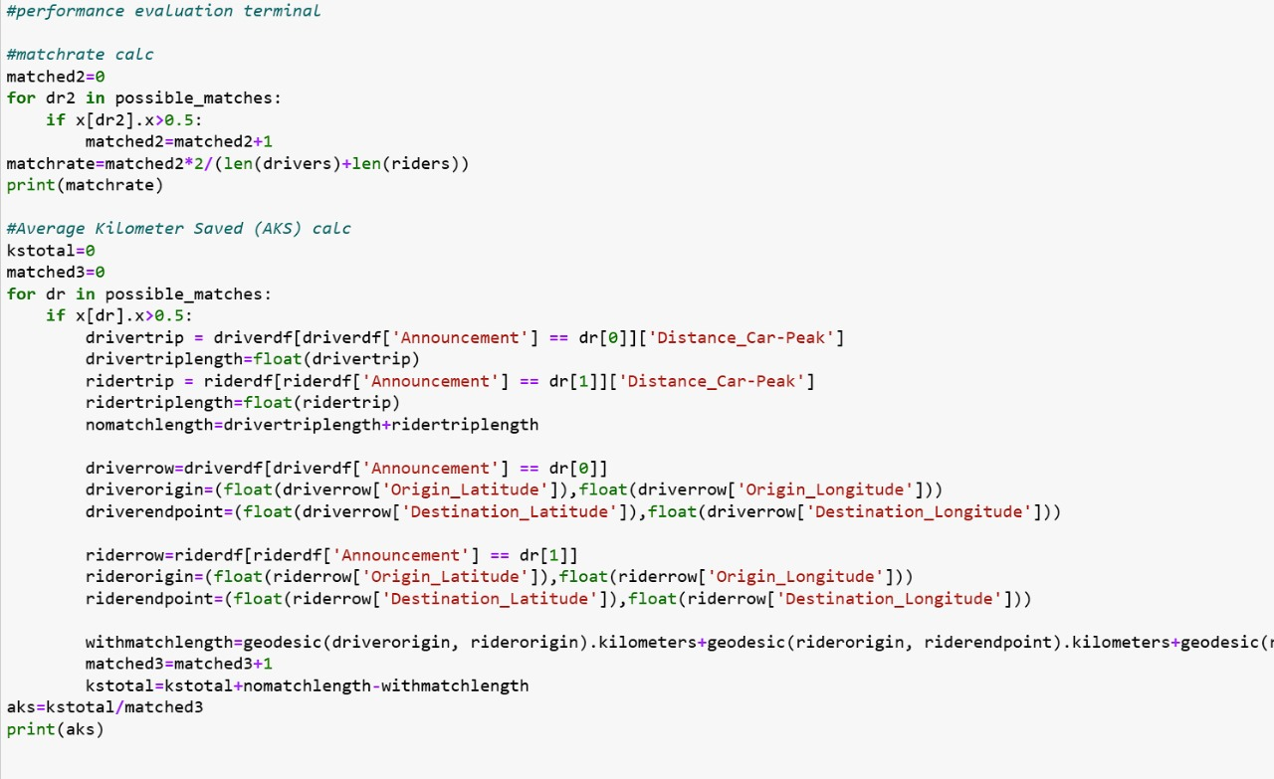
Code

